Slide 1

Online Examination System

Slide 2
ABSTRACT:
Online examination system is web based application for technical evaluation .Online examination system not only replaces paperwork but also releases the workload of faculty. It fulfils the requirements of the institutes to conduct the exams online . Students can give exam without the need of going to any physical destination. They can view the result at the sane time .Thus the purpose of the site is to provide a system that saves the efforts and time of faculty.
AGILE METHODOLOGY:
The Agile methodology is a way to manage a project by breaking it up into several phases. It involves constant collaboration with stakeholders and continuous improvement at every stage. Once the work begins, teams cycle through a process of planning, executing, and evaluating called sprints.

Slide 3

Initial sprint
Overall requirements gathering from customer
Estimating the time and price for the development of the product
Prioritize the features of the software
Assigning tasks to the team members

Slide 4
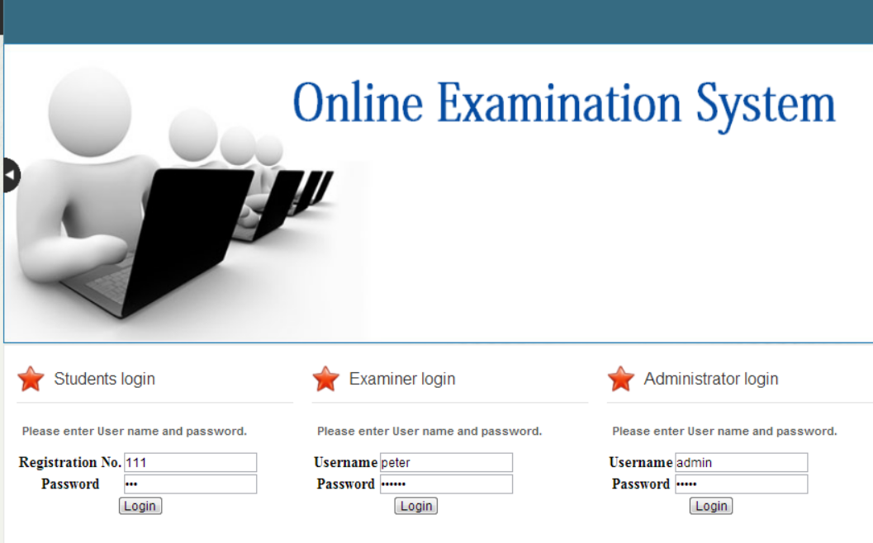
First sprint
Login page
Testing the features of the login page with the customer
Gathering the requirements for the next sprint

Slide 5
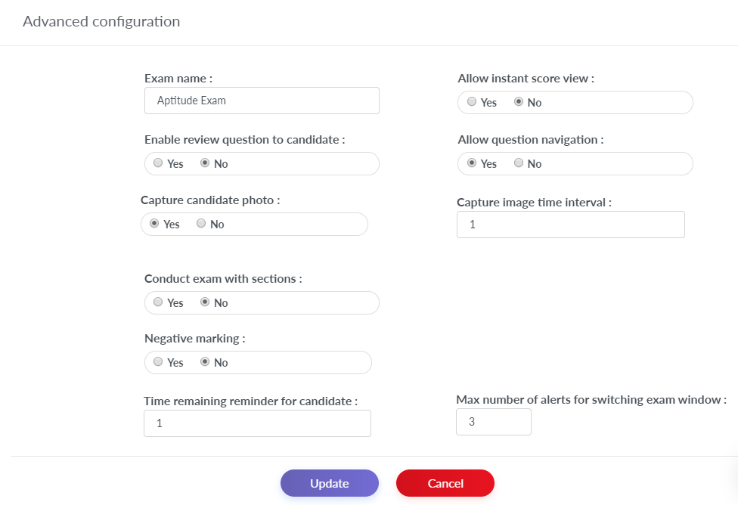
Second sprint
Created the feature of uploading exam questions and papers
Explaining the features in the product to the customer
Testing the features
Requirements for the next sprint

Slide 6
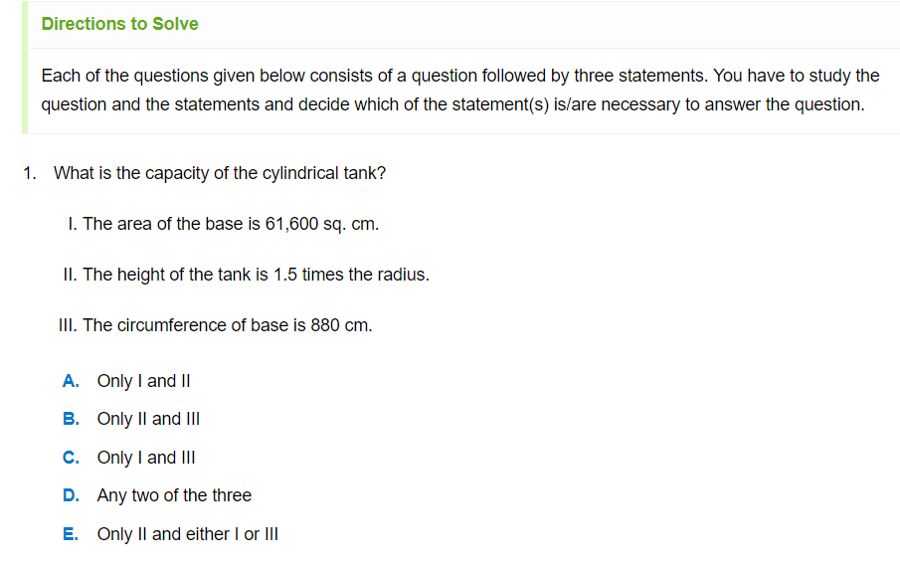
Third sprint
Added the feature of writing exam
Testing the feature with the customer
Gathering requirements for the next sprint

Slide 7

Final sprint ,maintenance and support
Added the feature of viewing the result
Final project testing
Discussions about the feature update and project update

Slide 8
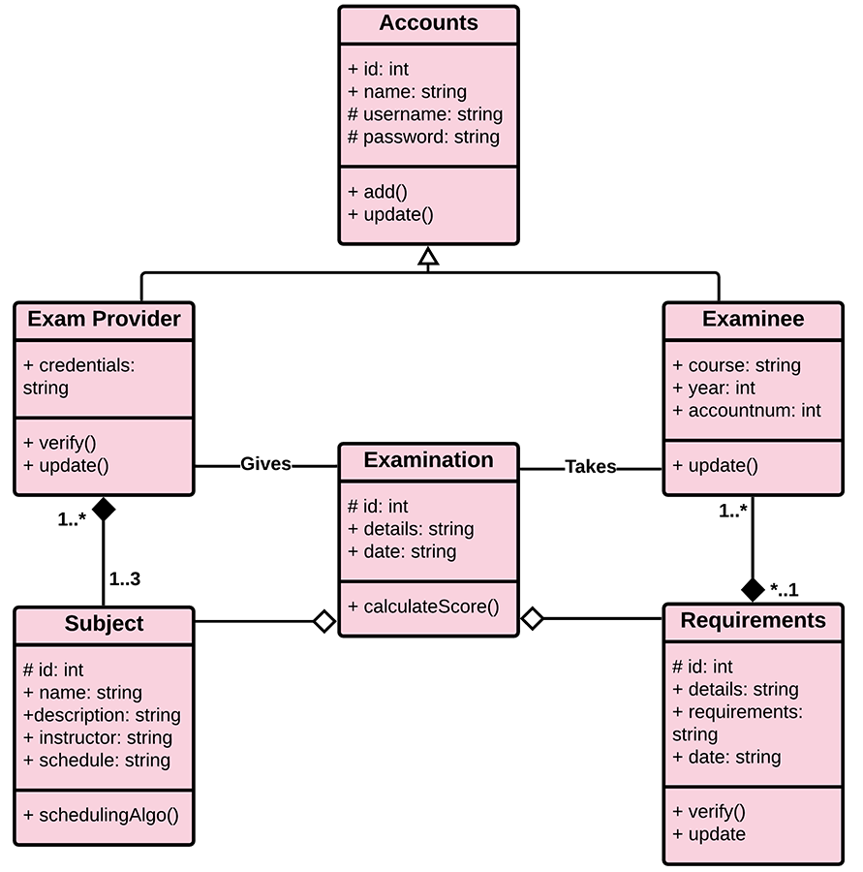
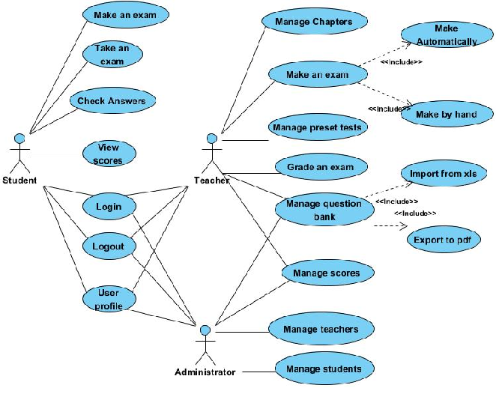
USE CASE
CLASS DIAGRAM

Slide 9
Thank you
TEAM MEMBERS:
Praveen V
Ratish MS
Arun
Karthikeyan MS
Thirumurugan K
Ajay raj Agarwal s
Ibrahim Navas s
Kabileshwaran
Jayaram

